Slide 1
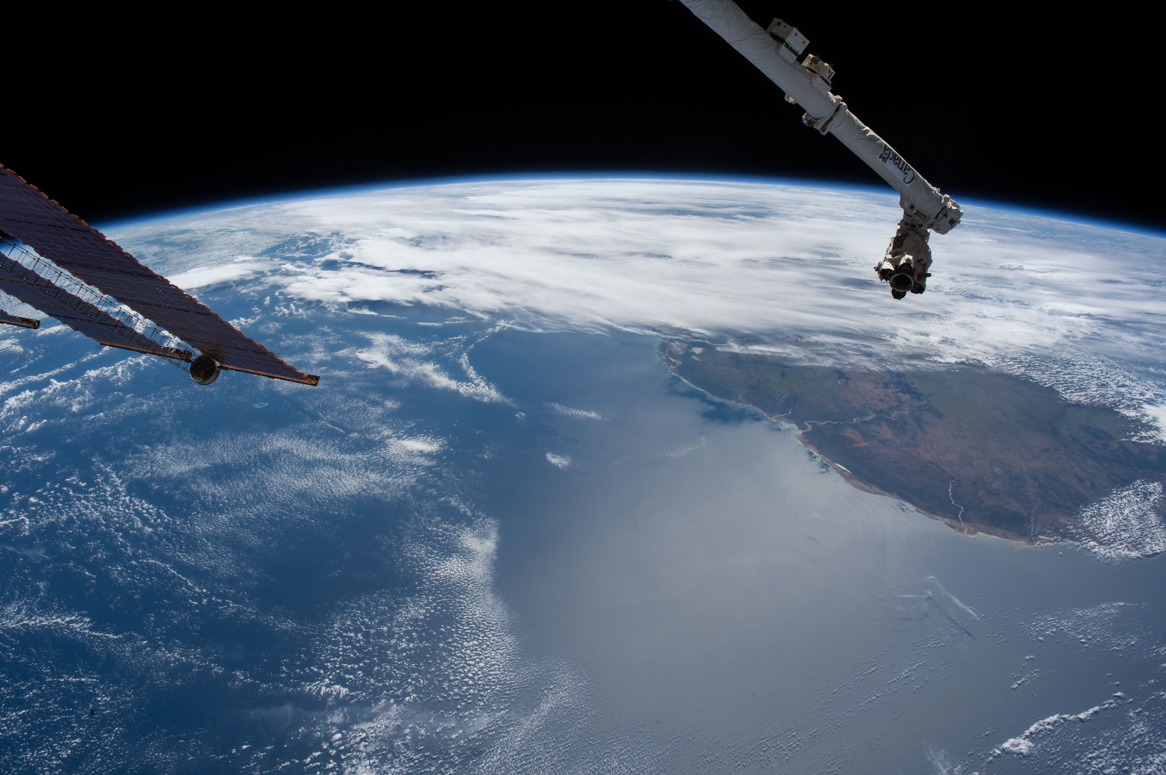
Using Computer Vision Techniques for Feature Detection in Astronaut Photography

Slide 2
What is Computer Vision?
Computer vision tasks include methods for acquiring, processing, analyzing and understanding digital images, and extraction of high-dimensional data from the real world in order to produce numerical or symbolic information, e.g., in the forms of decisions.
Computer vision - Wikipedia
https://en.wikipedia.org/wiki/Computer_vision

Slide 3
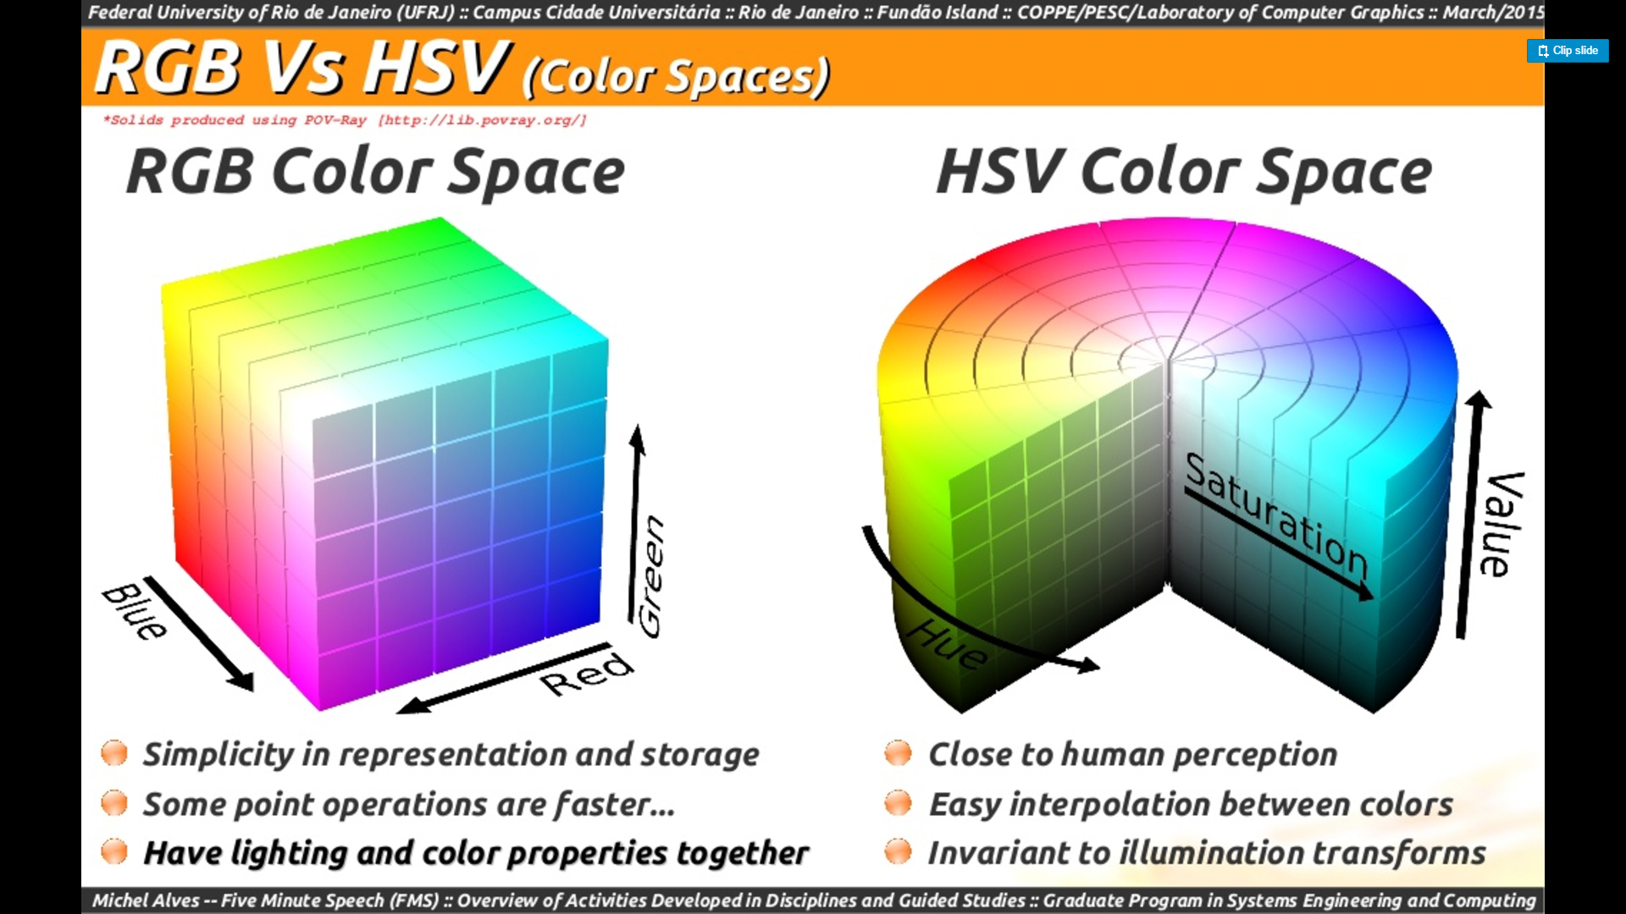
Detecting Aurora : Check the sun elevation (only looking at nightime images), reduce noise with a Gaussian filter, and convert the RGB Color Space to HSV Color Space. Algorithm was tuned to select pixels in a specified Hue, Saturation, and Value range.
colorLower = np.array([100, 30, 100], dtype="uint8") colorUpper = np.array([155, 150, 255], dtype="uint8")
mask = cv2.inRange(image, colorLower, colorUpper)

Slide 4
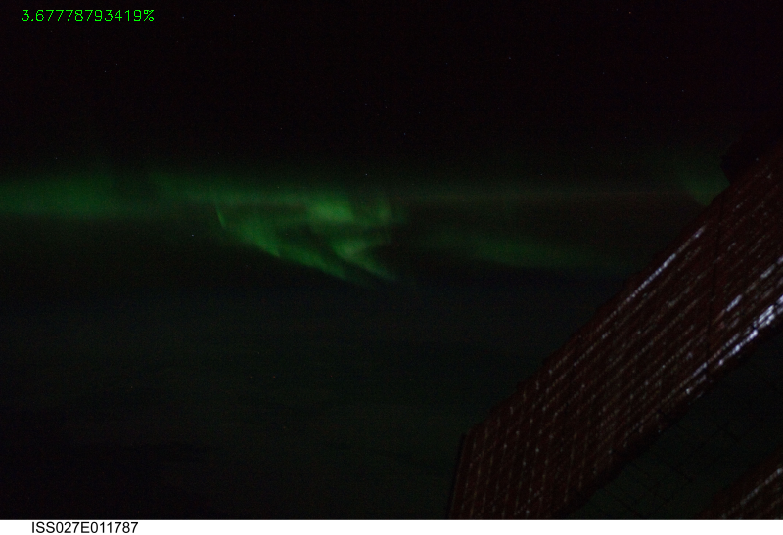
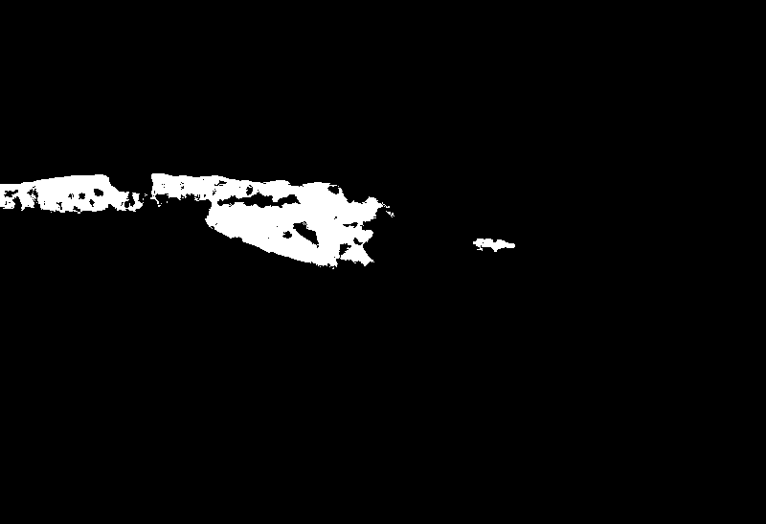
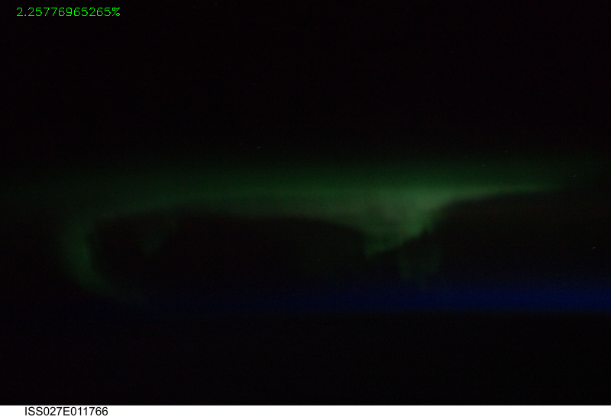
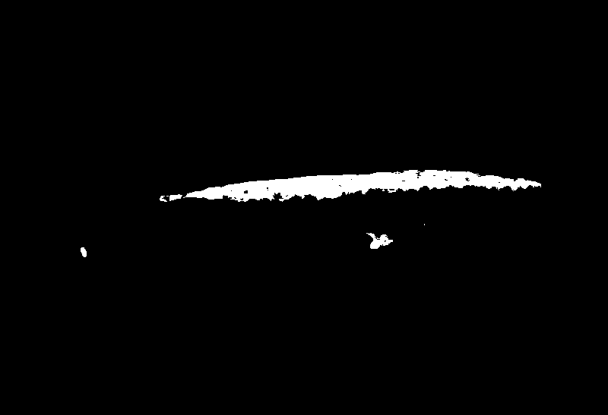
Result of checking pixels for the bright green color of an aurora :

Slide 5
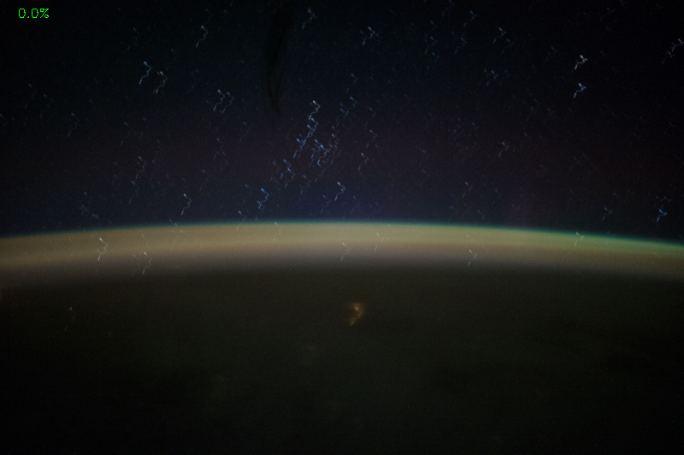

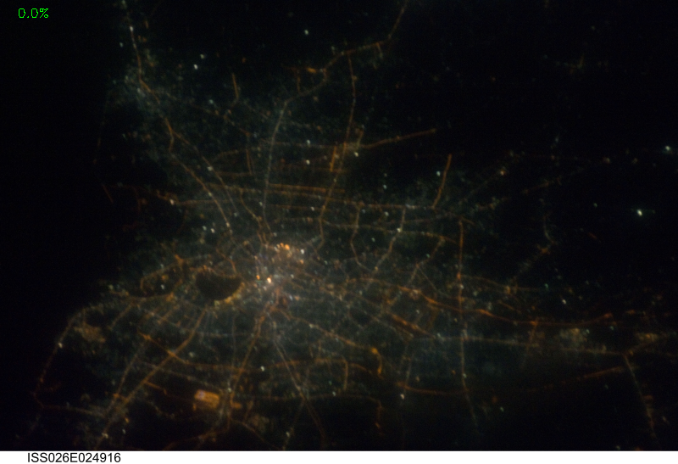
Algorithm is tuned to only detect aurora and not airglow or green city lights

Slide 6
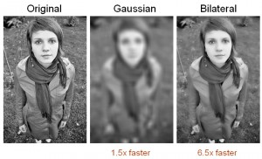
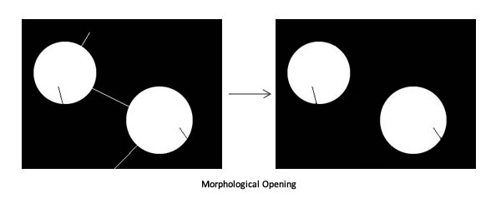

Slide 7
Detecting Nighttime Lightning :
The algorithm uses a combination of bilateral filtering, morphological opening, blob detection, and color masking.
Bilateral Filter : Reduces unwanted noise while keeping edges fairly sharp
Morphological Opening :
Blob Detection :
Color Masking :

Slide 8
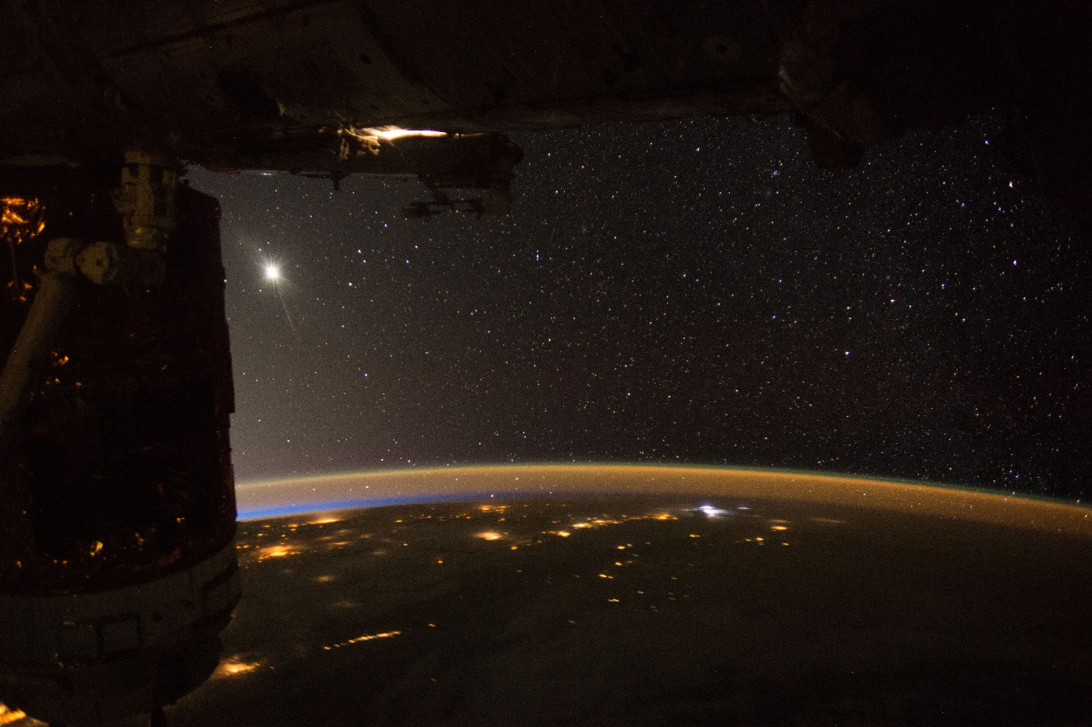


Original Image
Bilateral Filter
Morphological Opening

Slide 9
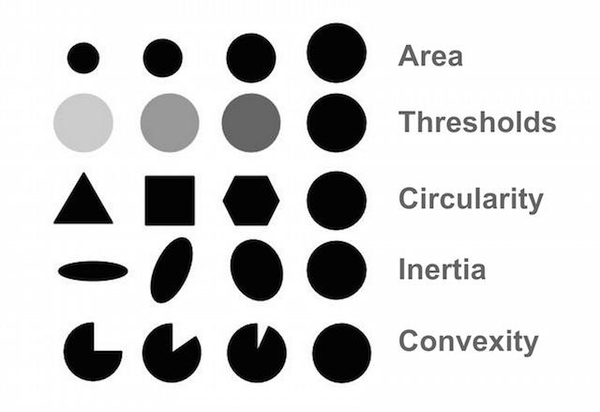

Slide 10
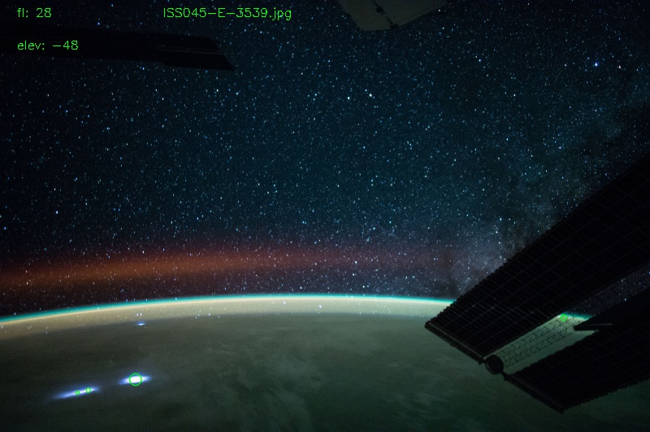
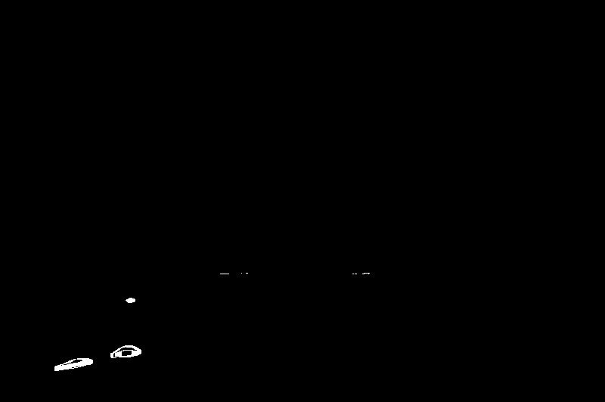

Slide 11
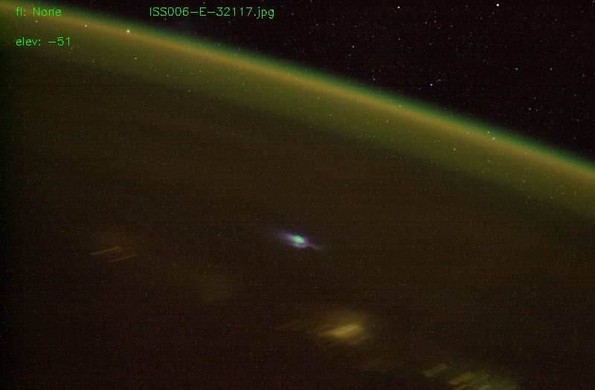
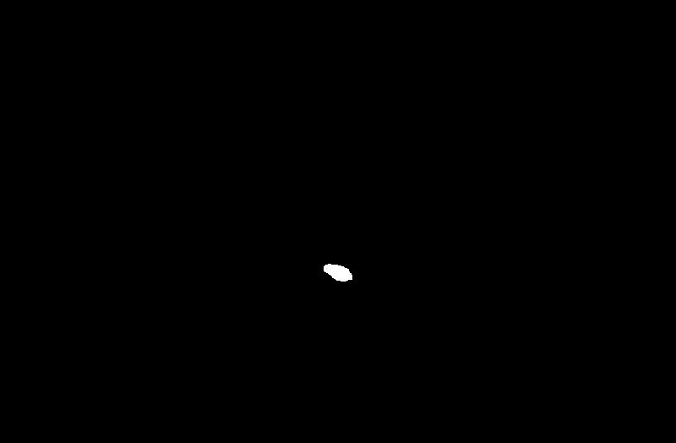

Slide 12
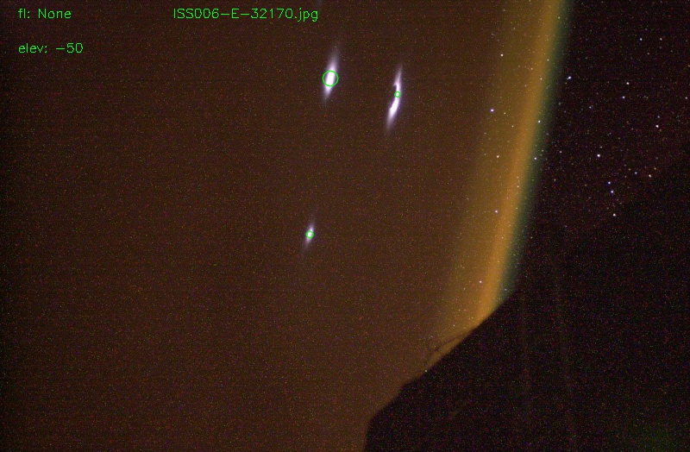
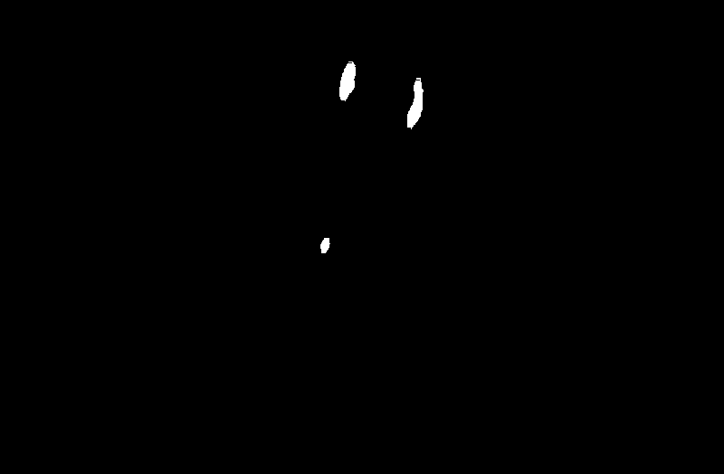

Slide 13
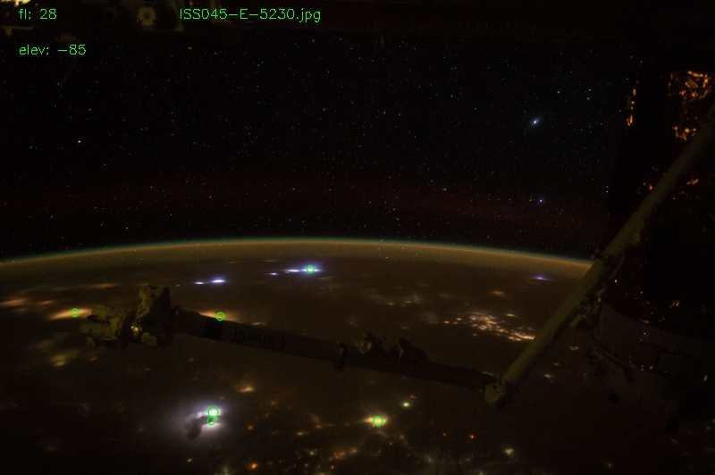
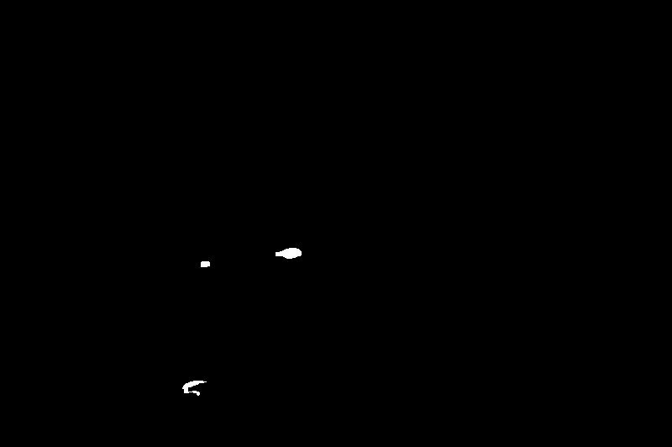

Slide 14
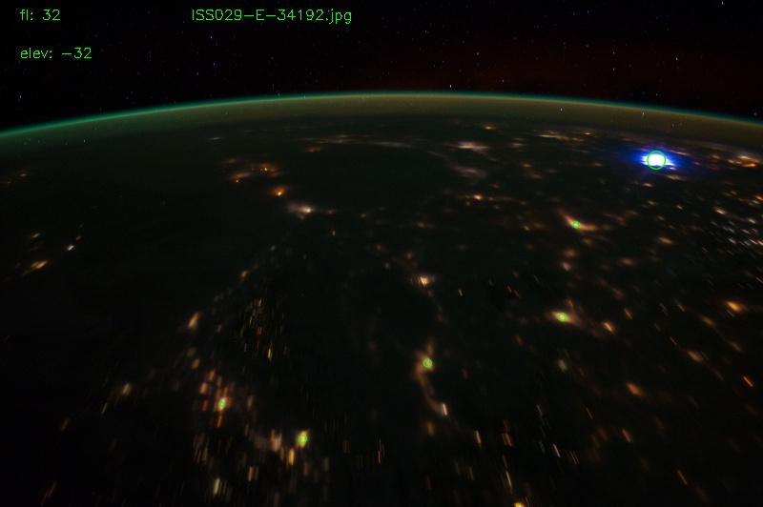


Slide 15
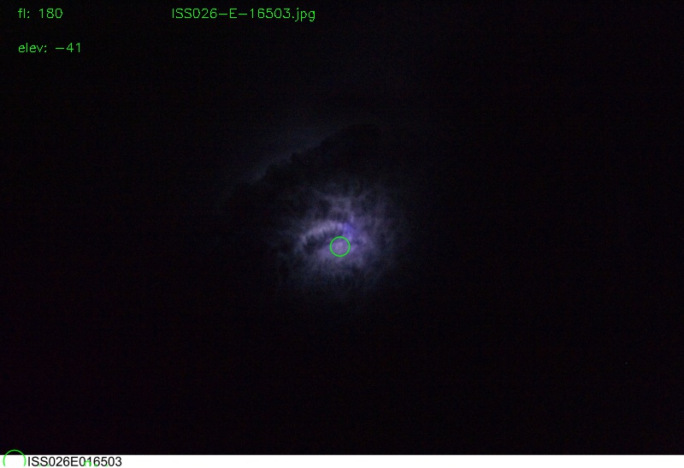
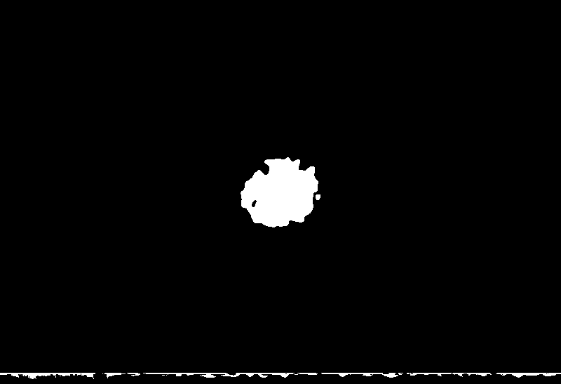

Slide 16
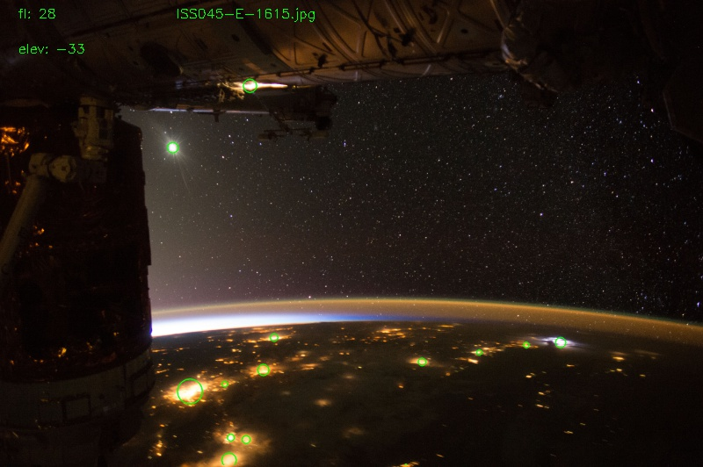
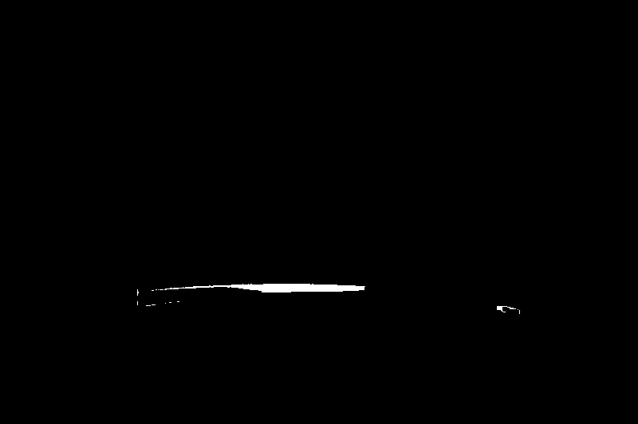

Slide 17
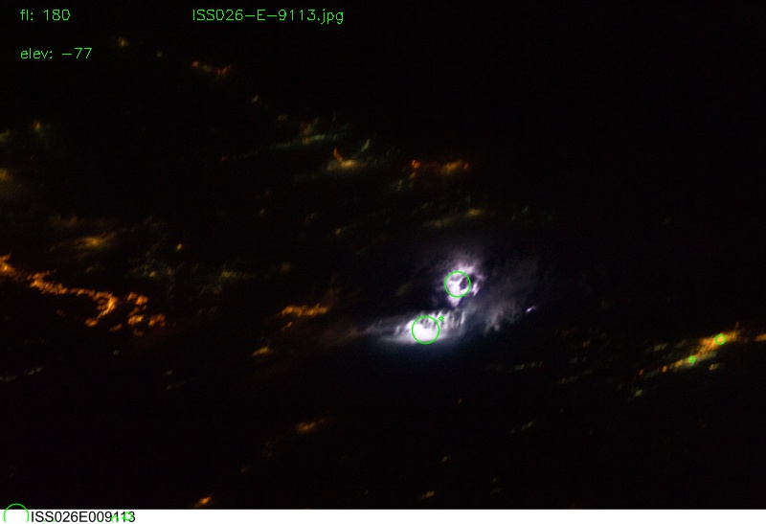
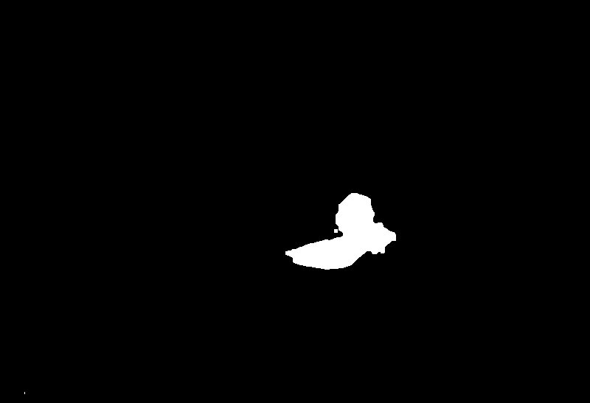

Slide 18
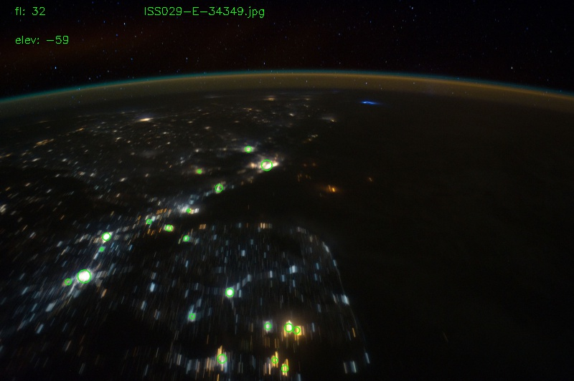
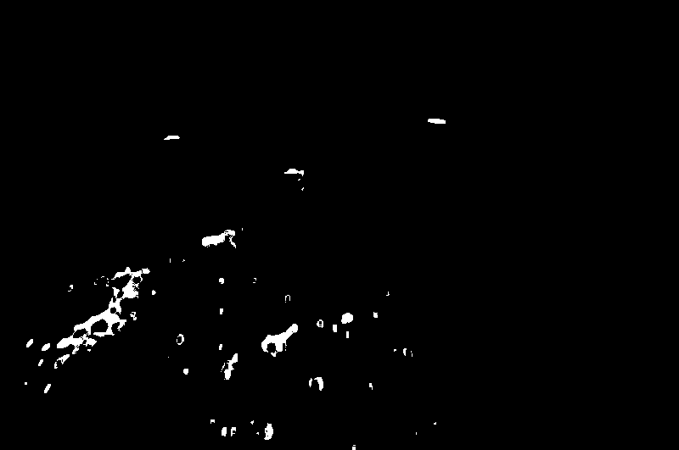

Slide 19
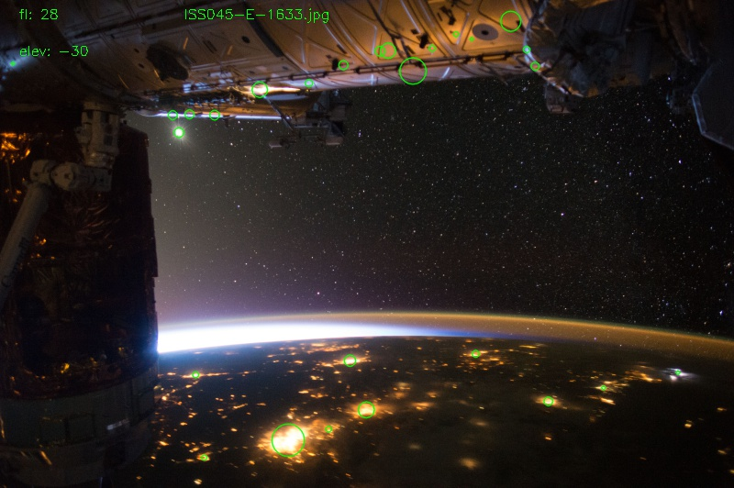
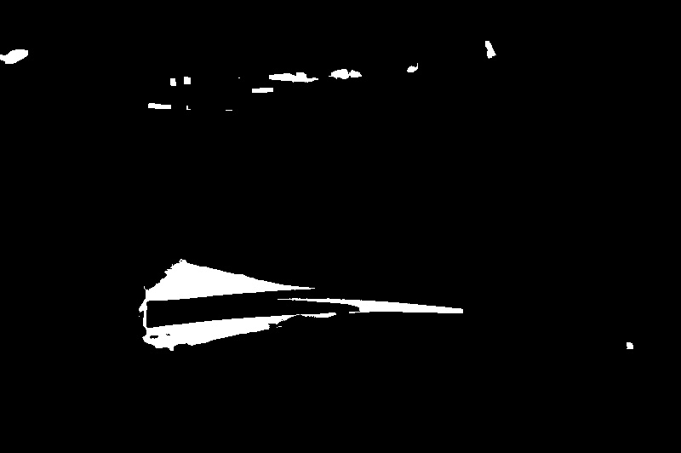

Slide 20
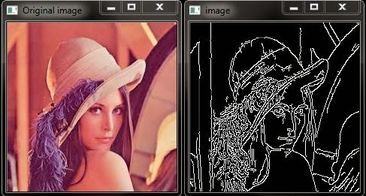

Slide 21
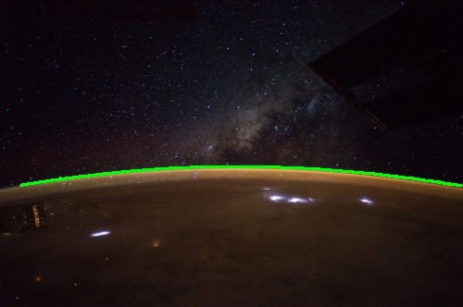

Slide 22
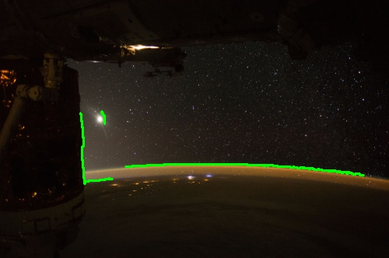

Slide 23
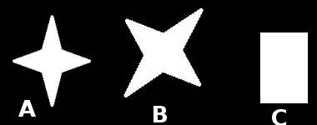
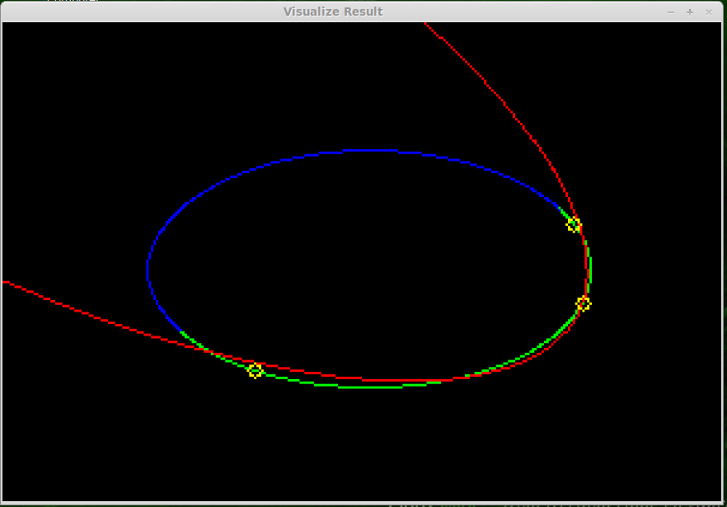
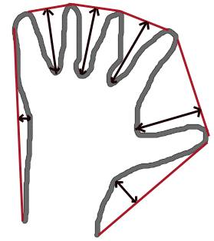
Methods for Finding the Earthlimb

Slide 24
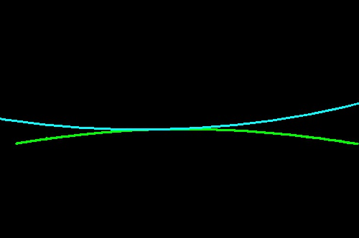
openCV Fit Ellipse Bug

Slide 25
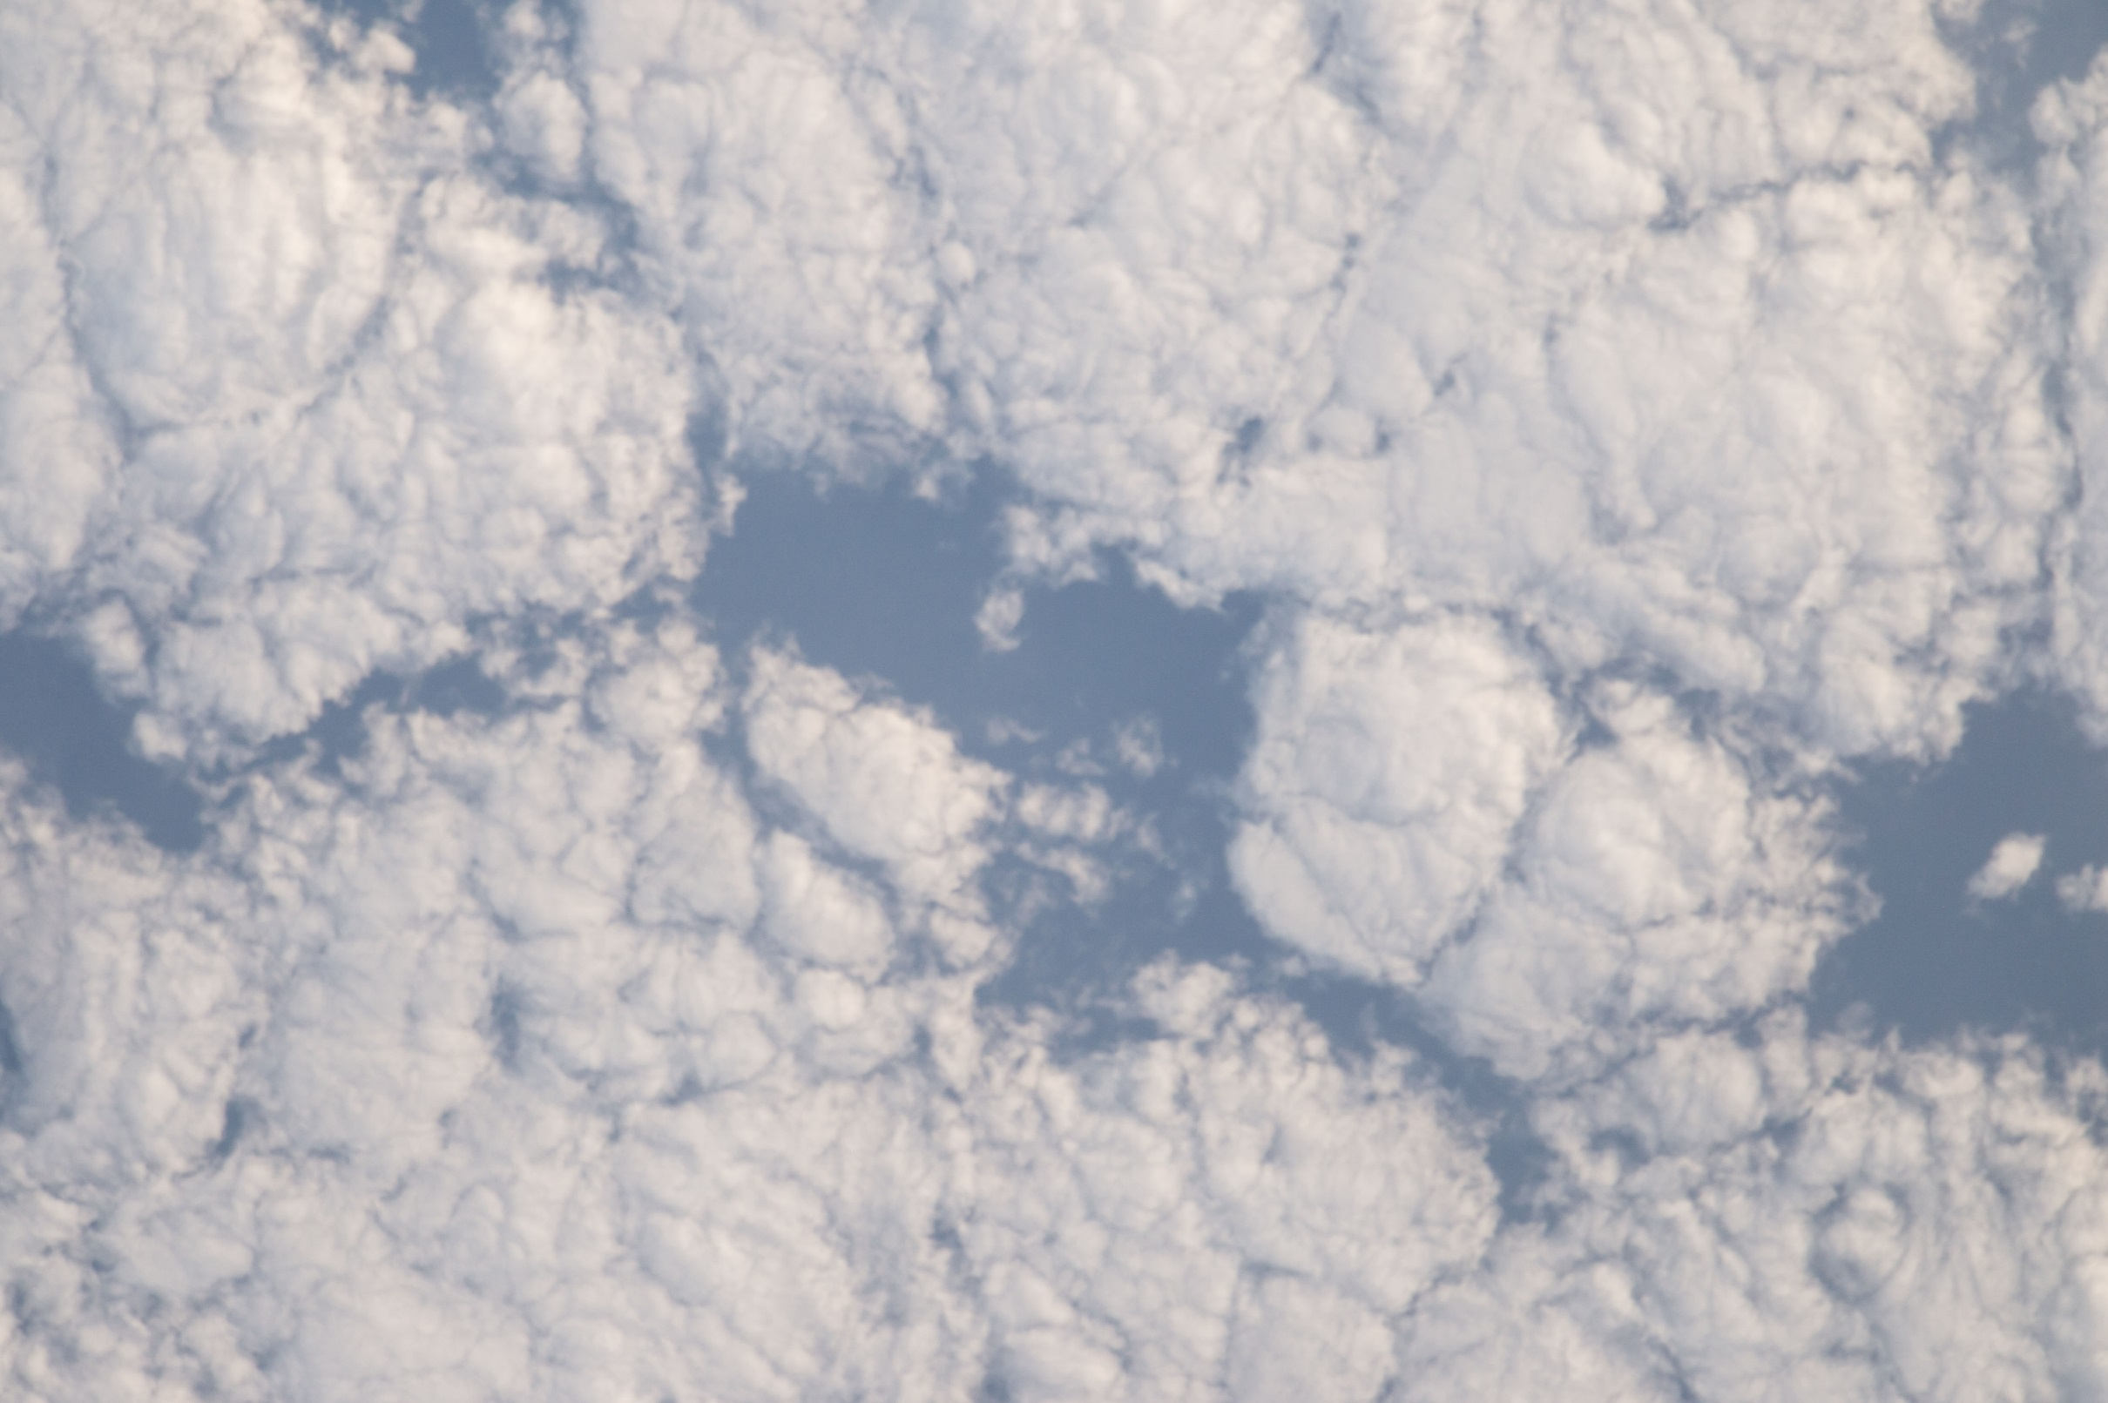
Cloud Detection

Slide 26
Local Binary Pattern and histograms
Train a Support Vector Machine with Local Binary Pattern histograms as Feature Space
Sliding Window

Slide 27
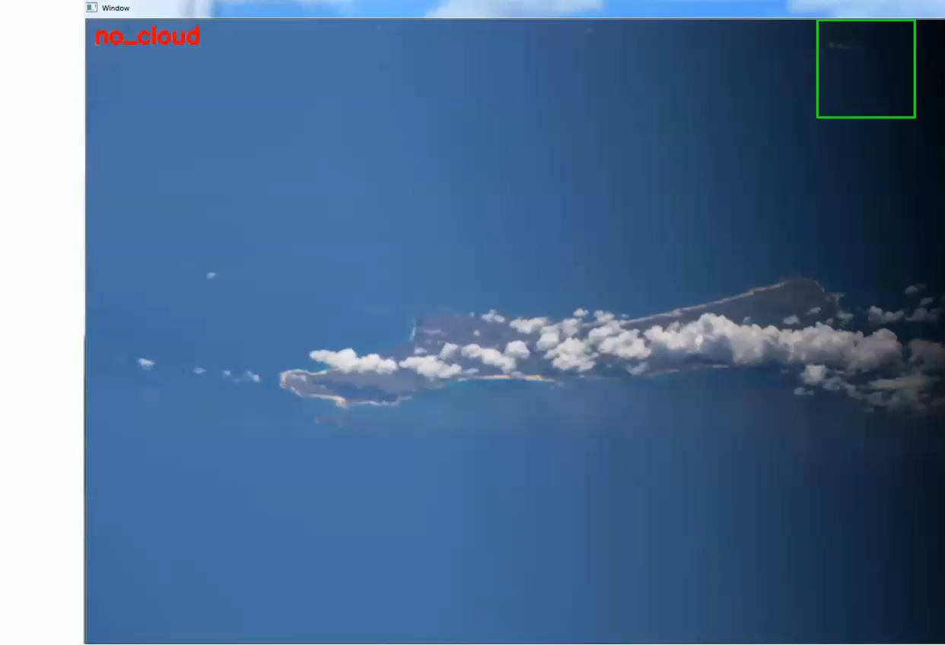
Cloud Detection Algorithm

Slide 28
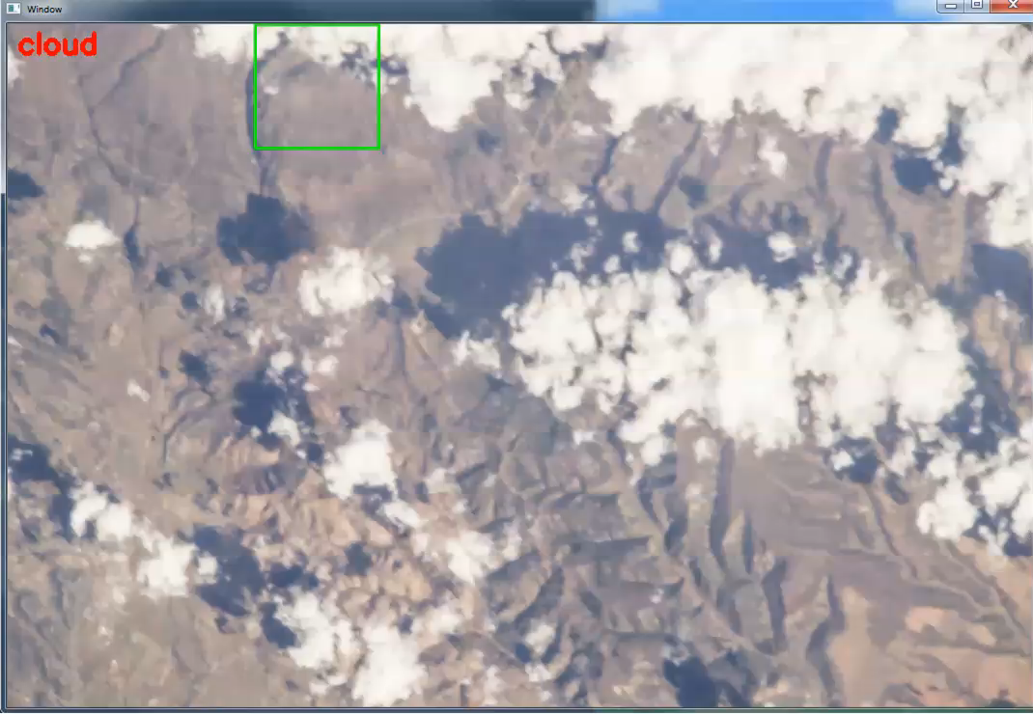

Slide 29
Automatically generate cloud and non- cloud training samples

Slide 30
Thresholding

Slide 31
Morphing (stars example)

Slide 32
Software used : Python and python libraries : OpenCV, Sklearn, Numpy

